Slide 1


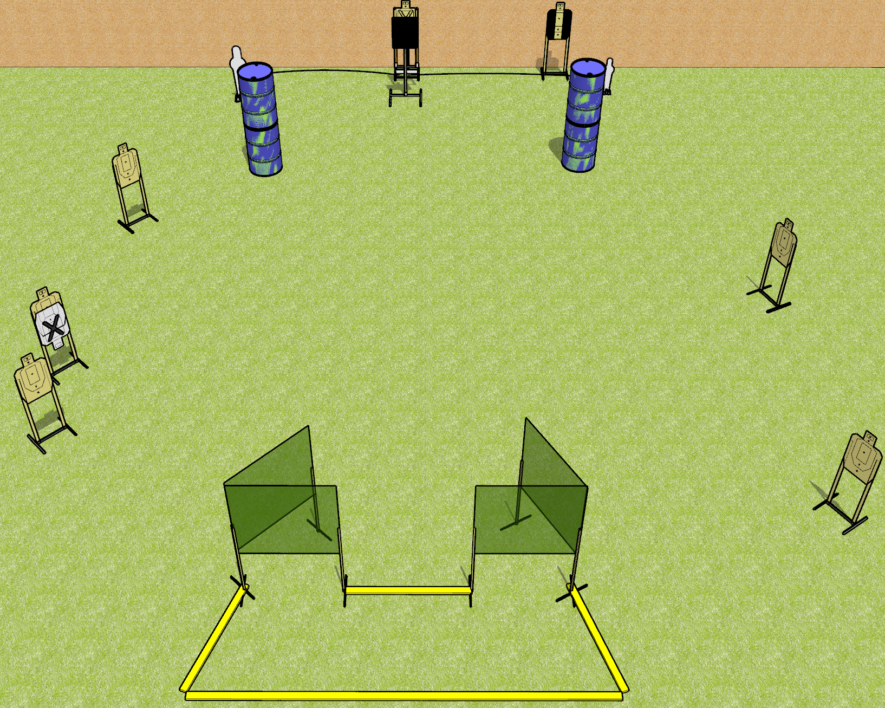
 | Dothan Gun Club – USPSA Match Yes Both Sides Course Designer : Drew Coleman
Round Count 16 rounds 7 USPSA targets 1 Pepper Popper, 1 Mini popper
Equipment List 8 wall feet 1 medium 1 bobber 1 18x24 inch plate + stand

Slide 2
Yes Both Sides
Written Stage Briefing
Yes Both Sides is a 16 round, 80 point, Comstock medium course. There are 7 USPSA targets, 1 pepper popper, and 1 USPSA mini popper. The best 2 hits on paper will score, and steel must fall to score. The start signal is audible.
The bobber is activated by either popper, and it is not a disappearing target. Please check the activator prior to walkthrough and make sure it set up the same way every time.
Handgun start position is anywhere inside the shooting area, wrists above shoulders. Handgun is loaded and holstered.
PCC start position is anywhere inside the shooting area. Loaded carbine is held with both hands, stock on belt, safety on.
On start signal, engage targets as they become available from within the shooting area.

Slide 3
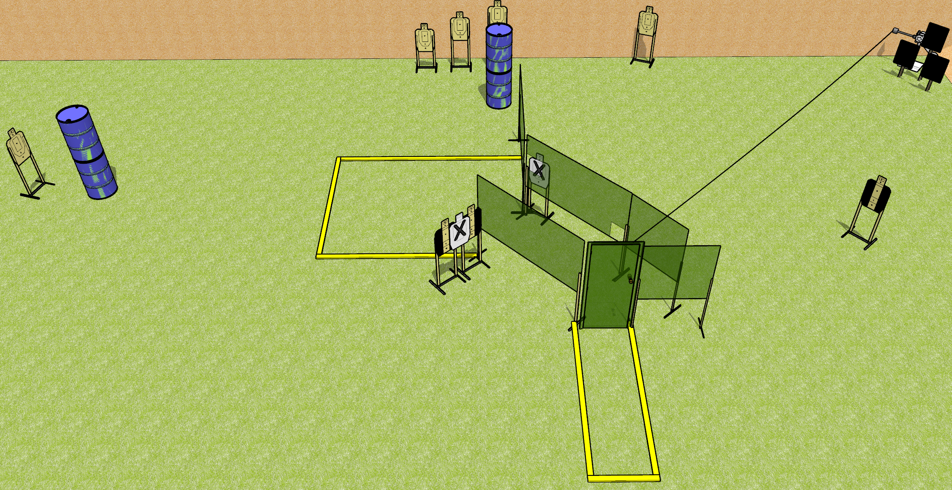
 | Dothan Gun Club – USPSA Match Out on a Wire Course Designer : Drew Coleman
Round Count 18 rounds 8 USPSA targets, 2 falling plates
Equipment List 9 wall feet Red stitch swinger + plates Door

Slide 4
Out on a Wire
Written Stage Briefing
Out on a Wire is an 18 round, 90 point, Comstock medium course. There are 8 USPSA targets and 2 falling plates. The best 2 hits on paper will score, and steel must fall to score. The start signal is audible.
The metal target is activated by opening the door, and must be activated before being engaged. Please check the activator prior to walkthrough and set it the same way every time.
Handgun start position is inside the shooting area, facing uprange, toes touching most uprange fault line, wrists above shoulders. Handgun is loaded and holstered.
PCC start position is inside the shooting area, facing downrange, heels touching most uprange fault line. Loaded carbine is held with both hands, stock on belt, safety on.
On start signal, engage targets as they become available from within the shooting area.

Slide 5
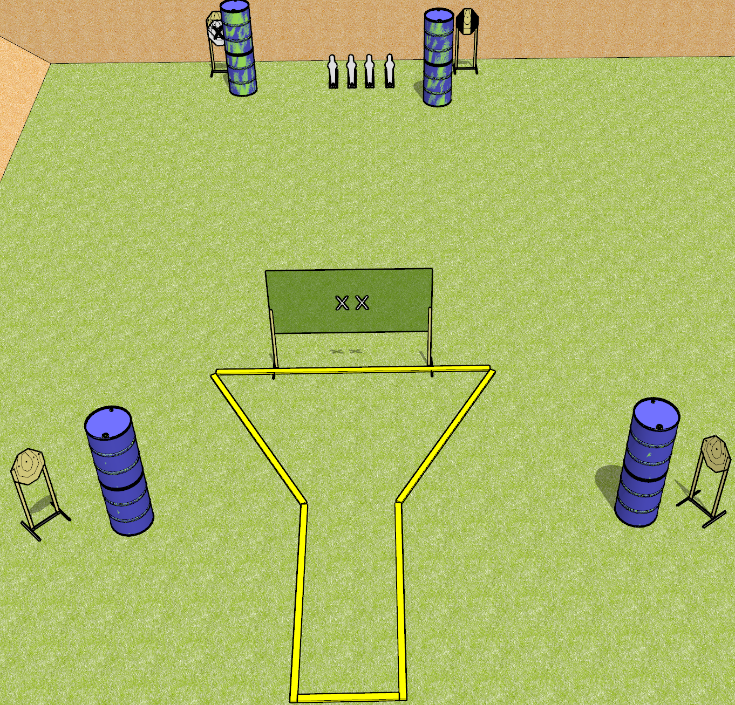
 | Dothan Gun Club – USPSA Match Four Turtles Course Designer : Drew Coleman
Round Count 20 4 IPSC Targets 4 USPSA Mini poppers
Equipment List 2 wall feet

Slide 6
Four Turtles
Written Stage Briefing
Four Turtles is a 100 point, Comstock medium course. There are 4 IPSC targets and 4 USPSA mini poppers. The best 4 hits on paper will score, and steel must fall to score. The start signal is audible.
Handgun start position is both hands on X’s. Handgun is loaded and holstered.
PCC start position is muzzle touching either X. Loaded carbine is held with both hands, shouldered, safety on.
On start signal, engage targets as they become available from within the shooting area.

Slide 7
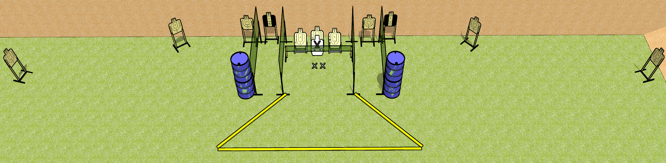
 | Dothan Gun Club – USPSA Match Spray and Pray Course Designer : Drew Coleman
Round Count 22 rounds 11 USPSA targets
Equipment List 10 wall feet 2 short walls 6 short target sticks

Slide 8
Spray and Pray
Written Stage Briefing
Spray and Pray is a 22 round, 110 point, Comstock field course. There are 11 USPSA targets. The best 2 hits on paper will score. The start is audible.
Handgun start position is feet on X’s, palms flat on top of wall in front of you. Handgun is unloaded and holstered.
PCC start position is feet on X’s, barrel touching top of wall in front of you. Unloaded carbine is held with both hands, safety on.
On start signal, engage targets as they become available from within the shooting area.

Slide 9
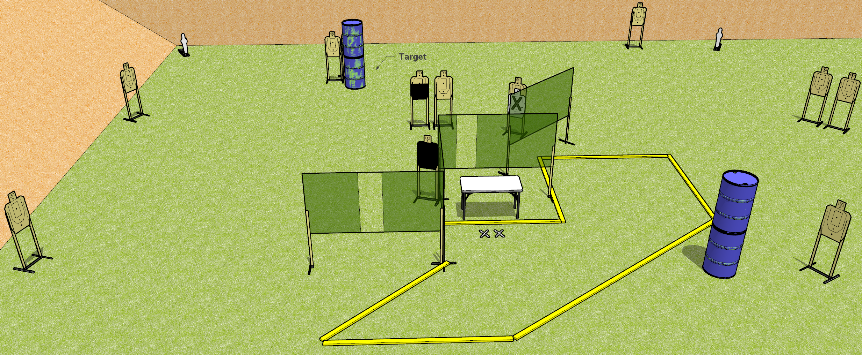
 | Dothan Gun Club – USPSA Match All on the Table Course Designer : Drew Coleman
26 rounds 12 USPSA Targets 2 USPSA mini poppers
12 target stands 6 wall feet 1 table

Slide 10
All on the Table
Written Stage Briefing
All on the table is a 26 round, 130 point, Comstock field course. There are 12 USPSA targets and 2 USPSA mini poppers. The best 2 hits on paper will score, and steel must fall to score. The start signal is audible.
Start position is both feet on X’s, fingers touching ears. Firearm is unloaded on table trigger guard on mark, lying unsupported. All magazines to be used during the stage are on table.
On start signal, engage targets as they become available from within the shooting area.

Slide 11
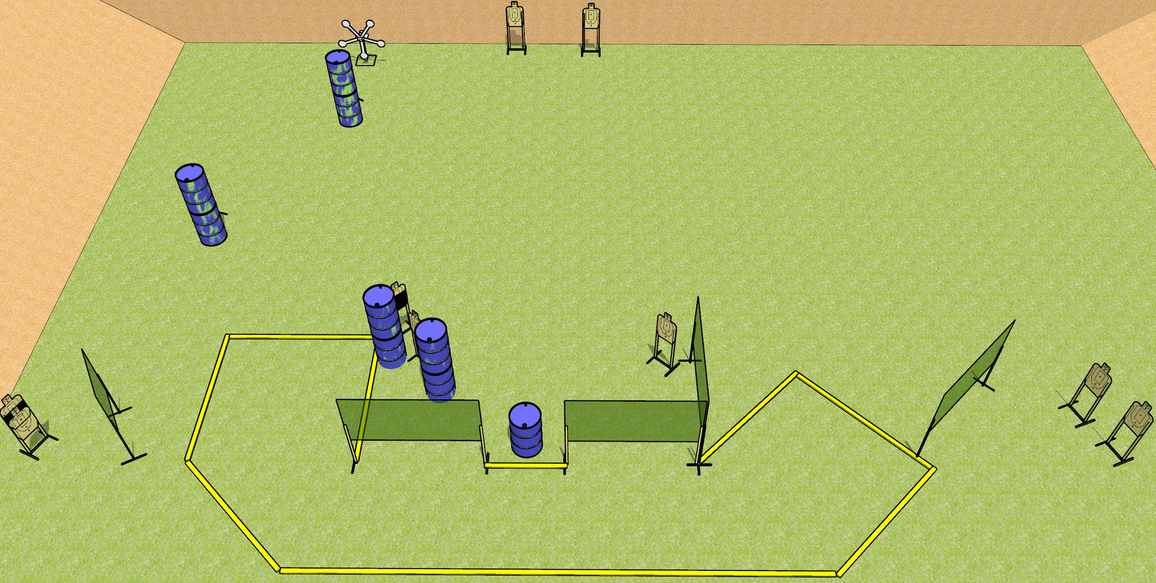
 | Dothan Gun Club – USPSA Match Not a Star Pun Course Designer : Drew Coleman
Round Count 27 rounds 11 USPSA targets 5 falling plates
Equipment List 1 Texas star 1 medium fault line 7 wall feet

Slide 12
Not a Star Pun
Written Stage Briefing
Not a Star Pun is a 27 round, 135 point, Comstock field course. There are 11 USPSA targets and 5 falling plates. The best 2 hits on paper will score and steel must fall to score. The start signal is audible.
Start position is toes touching the small fault line between the two walls (circled on diagram), palms flat on thighs. Firearm is on barrel, unloaded, laying unsupported with trigger guard on mark. All magazines are on belt.
Stage Procedure

Slide 13
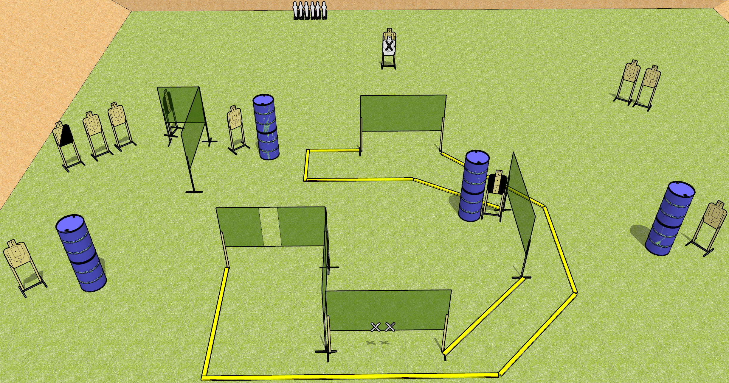
 | Dothan Gun Club – USPSA Match Just go Around Course Designer : Drew Coleman
Round Count 28 rounds 11 USPSA targets 6 mini poppers
Equipment List 11 wall feet 2 medium fault lines

Slide 14
Just Go Around
Written Stage Briefing
Just Go Around is a 28 round, 140 point, Comstock field course. There are 11 USPSA targets and 6 USPSA Mini Poppers. The best 2 hits on paper will score, and steel must fall to score. The start signal is audible.
Handgun start position is both hands touching X’s. Handgun is unloaded and holstered.
PCC start position is with muzzle touching either mark. Unloaded carbine is held with both hands, buttstock on belt, safety on.
On start signal, engage targets as they become available from within the shooting area.

Slide 15
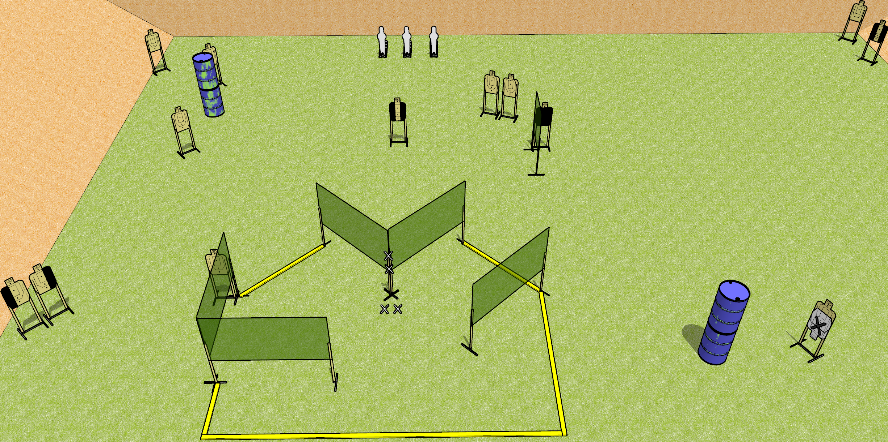
 | Dothan Gun Club – USPSA Match Nose on the Corner Course Designer : Drew Coleman
Round Count 29 Rounds 13 USPSA targets 3 pepper poppers
Equipment List 8 wall feet 1 medium fault line

Slide 16
Nose on the Corner
Written Stage Briefing
Nose on the Corner is a 29 round, 145 point, Comstock field course. There are 13 USPSA targets and 3 USPSA pepper poppers. The best two hits on paper will score and steel must fall to score. The start signal is audible.
Handgun start position is both hands touching marks on wall, feet on X’s. Handgun is unloaded and holstered.
PCC start position is muzzle touching lower mark, feet on X’s. Unloaded carbine is held with both hands, stock on belt.
On start signal, engage targets as they become available from within the shooting area.

Slide 17
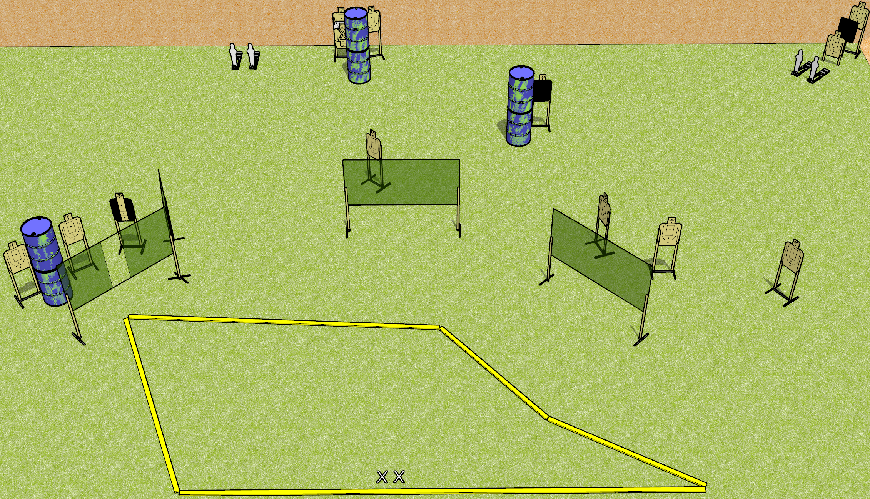
 | Dothan Gun Club – USPSA Match Ping Ping Course Designer : Drew Coleman
Round Count 30 13 USPSA targets 4 USPSA mini poppers
Equipment List 8 wall feet 1 18x24 plate + stand

Slide 18
Ping Ping
Written Stage Briefing
Ping Ping is a 30 round, 150 point, Comstock field course. There are 13 USPSA targets and 4 USPSA mini poppers. The best 2 hits on paper will score, and steel must fall to score. The start signal is audible.
Handgun start position is both feet on X’s, wrists above shoulders. Handgun is loaded and holstered.
PCC start position is both feet on X’s. Loaded carbine is held with both hands, buttstock on belt, safety on.
On start signal, engage targets as they become available from within the shooting area.

Slide 19
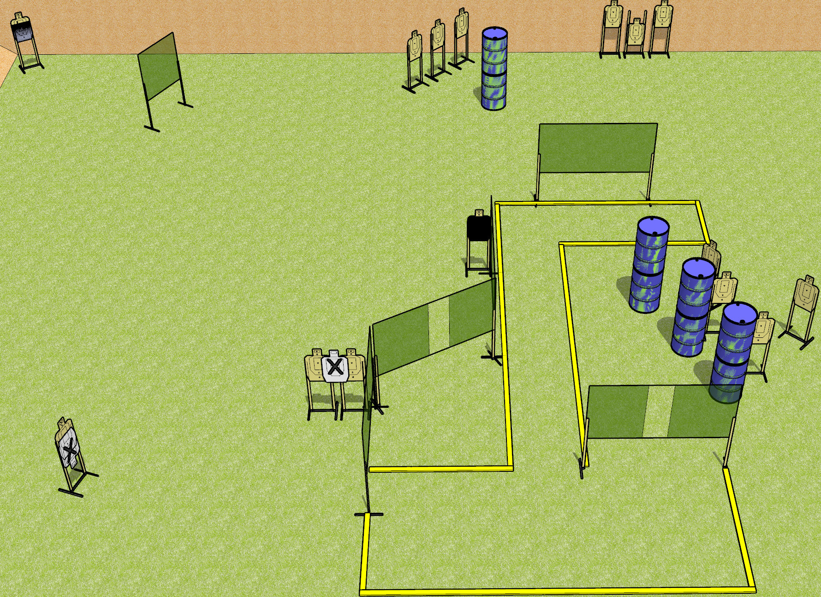
 | Dothan Gun Club – USPSA Match Aim Small Miss Small Course Designer : Drew Coleman
Round Count 30 rounds 15 USPSA targets
Equipment List Upper left target – Action target, hard cover is 5” down from shoulder perf 12 wall feet (SETUP NOTE) – the upper left target should be 20-25 yards from the positions it can be engaged from

Slide 20
Aim Small Miss Small
Written Stage Briefing
Aim Small Miss Small is a 30 round, 150 point, Comstock field course. There are 15 USPSA targets. The best 2 hits on paper will score. The start signal is audible.
Handgun start position is anywhere completely outside the shooting area, wrists below belt. Handgun is loaded and holstered.
PCC start position is anywhere completely outside the shooting area. Loaded carbine is held with both hands, stock on belt, safety on.
On start signal, engage targets as they become available from within the shooting area.

Slide 21
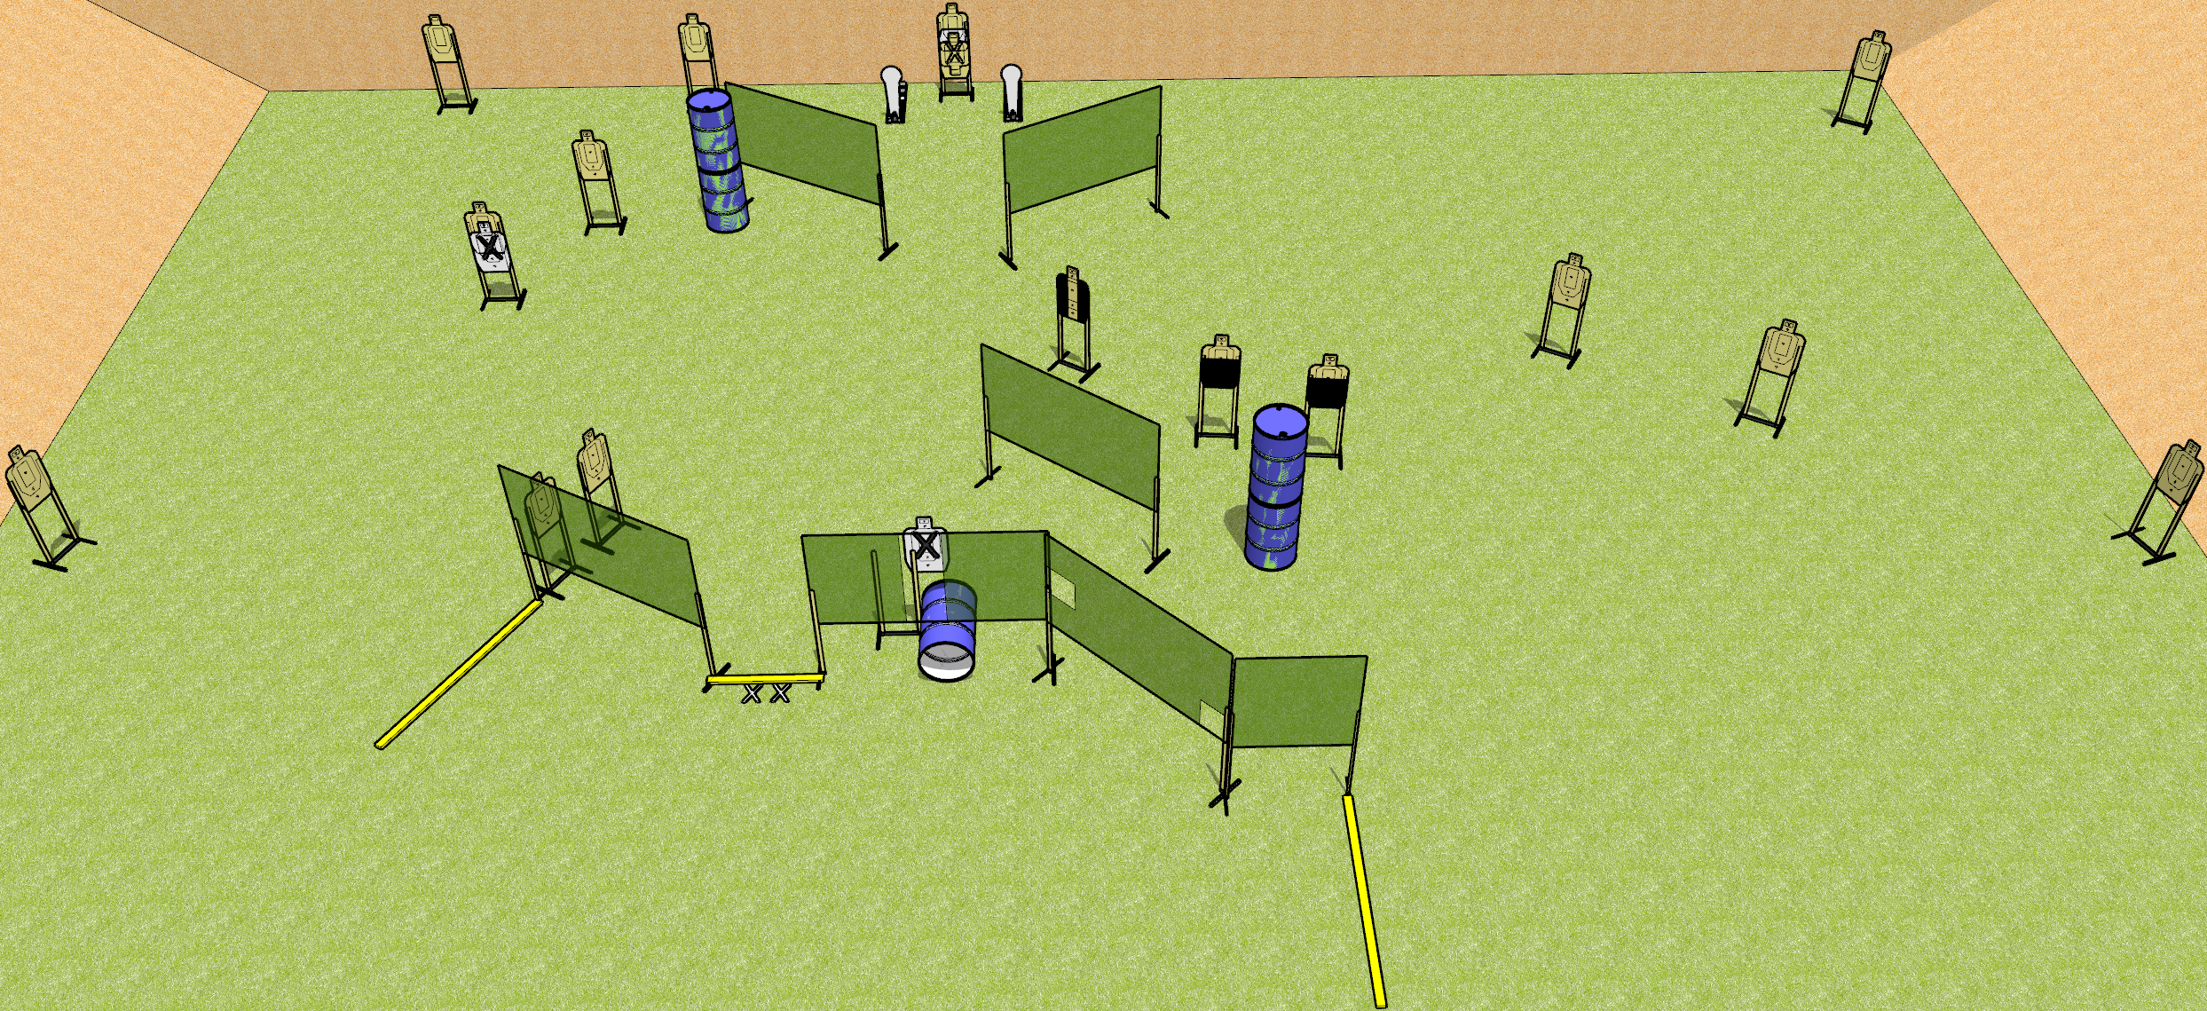
 | Dothan Gun Club – USPSA Match Down Low Course Designer : Drew Coleman
Round Count 34 rounds 16 USPSA targets 2 Colt poppers
Equipment List 14 wall feet Barrel with nail holes drilled in the side 1 medium fault line

Slide 22
Down Low
Written Stage Briefing
Down Low is a 34 round, 170 point, Comstock field course. There are 16 USPSA targets and 2 colt poppers. The best 2 hits on paper will score, and steel must fall to score. The start signal is audible.
Handgun start position is both feet on X’s, wrists below belt. Handgun is loaded and holstered.
PCC start position is both feet on X’s. Loaded carbine is held with both hands, stock on belt, safety on.
On start signal, engage targets as they become available from within the shooting area.

